Slide 1
Flow Chart for Heart Disease
Risk Calculator
Will Cocos, Cait Christopher, Garrett White
BMES 550

Slide 2
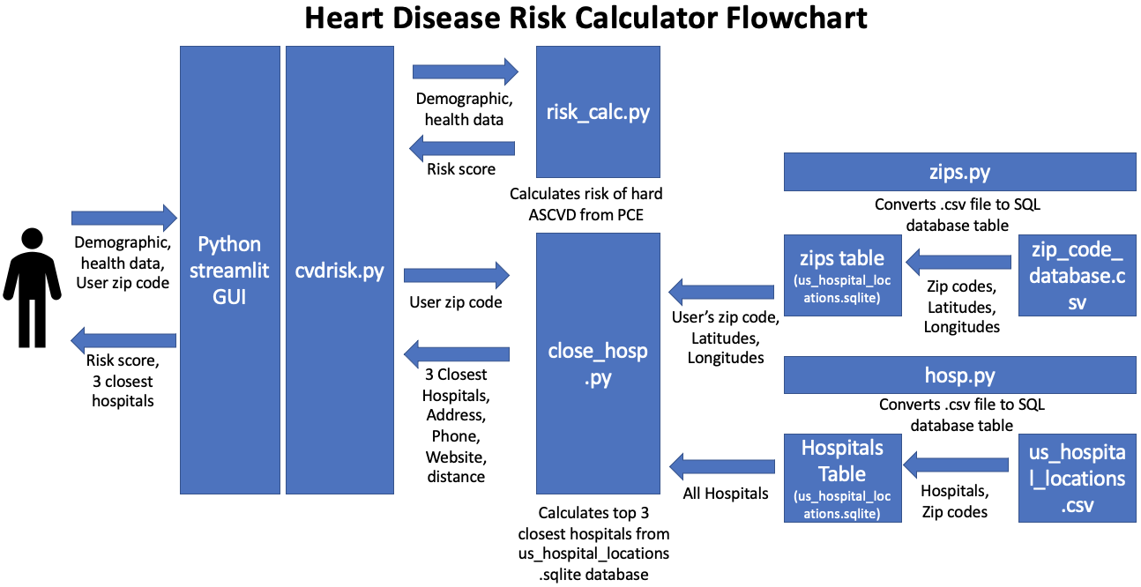

Slide 3
Function/Feature Name | Input | Output | Purpose | Responsibility
cvdrisk.py | User input information (i.e., sex, age, race, blood pressure, diabetes, zip code) | Risk of ASCVD as a percentage Three nearest hospitals based on distance | This is the main GUI which takes in various user inputs | Will & Garrett
risk_calc.py | User input information (i.e., sex, age, race, blood pressure, diabetes, etc.) for Pooled Cohort Equations (PCE) | Risk of ASCVD as a percentage | Is called by cvdrisk.py to calculate the user’s cardiovascular risk and return it back a percentage | Will
close_hosp.py | User zip code | 3 closest hospitals and their addresses, website, distance, etc. | To show the three closest hospitals in case they need treatment | Garrett
hosp.py | us_hospital_locations.csv file containing hospital information | Stores hospital data into SQL database, us_hospital_locations.sqlite | To locate all hospitals in the United States | Cait
zips.py | zip_code_database.csv file containing zip codes and latitudes/longitudes | Stores zip code data into SQL database, us_hospital_locations.sqlite | To be able to identify the three closest hospitals based on latitude and longitude | Cait & Will
zip_code_database.csv | N/A | Zip codes, latitudes, longitudes, etc. | Contains all of the zip code information that is then run through the zips.py file | Will

